Slide 1
Program Security

Slide 2
Program Security
Protecting programs is the heart of computer security
All kinds of programs, applications, operating systems and database systems etc.
A program is secure if it provides confidentiality, integrity and availability.

Slide 3
Secure programs
Security implies some degree of trust that the program enforces expected confidentiality, integrity, and availability.
An assessment of security can also be influenced by someone's general perspective on software quality.
For example, one person may decide that code is secure because it takes too long to break through its security controls. And someone else may decide code is secure if it has run for a period of time with no apparent failures.

Slide 4
PROGRAM SECURITY
Program security is an idea implemented to protect software/program against malicious attack and other hacker risks so that the software continues to function correctly under such potential risks. Security is necessary to provide integrity, authentication and availability.

Slide 5
Program security is difficult
Security often conflicts with usefulness and performance.
It is essentially impossible to ensure that program does only what it is designed to do and nothing else.
Programming and software engineering techniques change faster than computer security techniques.
Even a single flaw can be catastrophic.

Slide 6
Program Security
Fault tolerance terminology:
Error-may lead to a fault
Fault-a deviation from intended functionality
Failure- system malfunction caused by fault
Two categories of faults(classified by duration)
Permanent faults
Transient faults-can be much more difficult to diagnose.

Slide 7
Transient Faults
Transient faults include the momentary loss of network connectivity to components and services, the temporary unavailability of a service, or timeouts that arise when a service is busy.
These faults are often self-correcting, and if the action is repeated after a suitable delay it is likely to succeed.

Slide 8
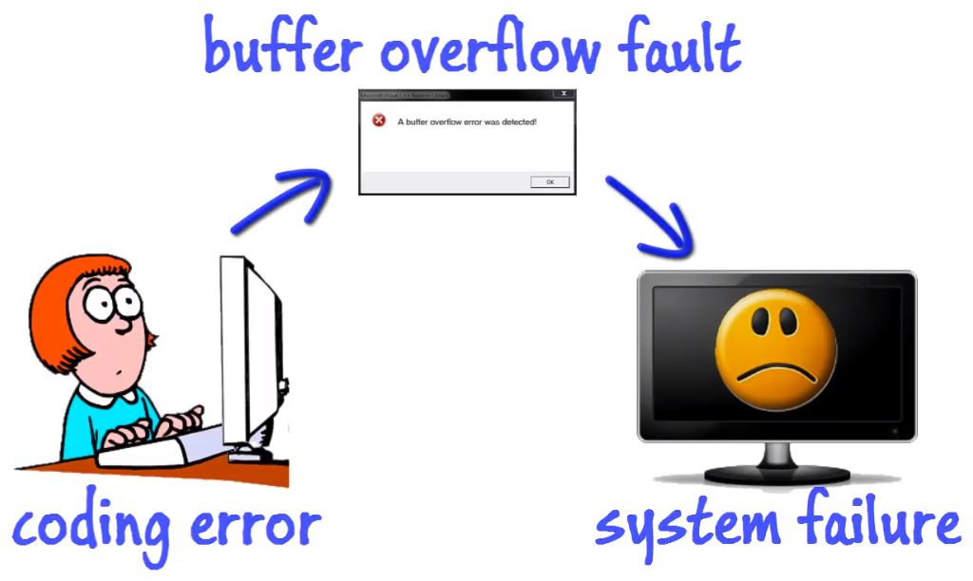

Slide 9
Types of program flaws
Intentional
Malicious
Nonmalicious
Inadvertent
Validation error (incomplete or inconsistent)
e.g., incomplete or inconsistent input data
Domain error
e.g., using a variable value outside of its domain
Serialization and aliasing
serialization – e.g., in DBMSs or OSs
aliasing - one variable or some reference, when changed, has an indirect (usually unexpected) effect on some other data
Inadequate ID and authentication
Boundary condition violation
Other exploitable logic errors

Slide 10
Non malicious program errors
Most of the mistakes made by the programmers are unintentional and non malicious.
Many such errors will not lead to more serious vulnerabilities but few will put many security professionals in trouble.
We look at three such classic error types and explain why they are relevant to security and how can they be prevented.

Slide 11
Buffer overflows
Its like pouring 2 liters of water into a 1 liter jug.
Definition
A buffer is a space in memory in which data is held.
As memory in finite => buffer capacity is finite
Therefore, in programming languages the programmer must declare the buffers maximum size.

Slide 12
Buffer overflow example -C
char sample[10];
// compiler sets 10 bytes to store this buffer.
sample[10]=‘B’;
// out of bounds error, compiler detects this during compilation.
Now, what if we do
sample[i]=‘B’;
In some programming languages, buffer sizes need not be predefined.
C does notperform array bounds checking.
Similar problem caused by pointers--No reasonable way to define limits for pointers

Slide 13
Buffer overflows
for (i=0; i<=9; i++) sample[i] = 'A'; sample[10] = 'B'
Where does ‘B’ go?
Depends on what is adjacent to ‘sample[10]’
Affects user’s data- overwrites user’s data
Affects users code- changes user’s instruction
Affects OSdata- overwrites OS data
Affects OScode- changes OS instruction

Slide 14
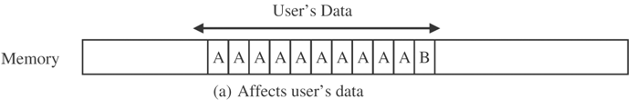
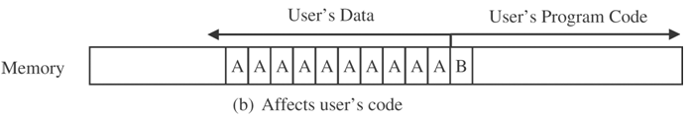
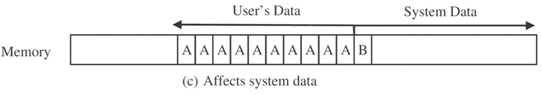
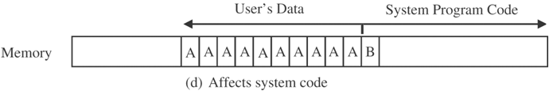
Buffer overflows

Slide 15
Implications of buffer overflow:
Attacker can insert malicious data values/instruction codes into “overflow space”
Buffer overflow affects OS code area
Attacker code executed as if it were OS code
Attacker might need to experiment to see what happens when he inserts B into OS code area
Can raise attacker’s privileges(to OS privilege level)
When B is an appropriate instruction
Attacker can gain full control of OS

Slide 16
Incomplete mediation
Incomplete mediation flaw — often inadvertent (=> nonmalicious) but with serious security consequences
Incomplete mediation:
Sensitive data are in exposed, uncontrolled condition
Example
URL to be generated by client’s browser to access server, e.g.:
http://www.things.com/order/final&custID=101&part=555A&qy=20&price=10&ship=boat&shipcost=5&total=205
Instead, user edits URL directly, changing price and total cost as follows: http://www.things.com/order/final&custID=101&part=555A&qy=20&price=1&ship=boat&shipcost=5&total=25
User uses forged URL to access server
The server takes 25 as the total cost

Slide 17
Unchecked data are a serious vulnerability!
Possible solution: anticipate problems
Don’t let client return a sensitive result (like total) that can be easily recomputed by server
Use drop-down boxes / choice lists for data input
Prevent user from editing input directly
Check validity of data values received from client
Do not rely solely on client-side validation

Slide 18
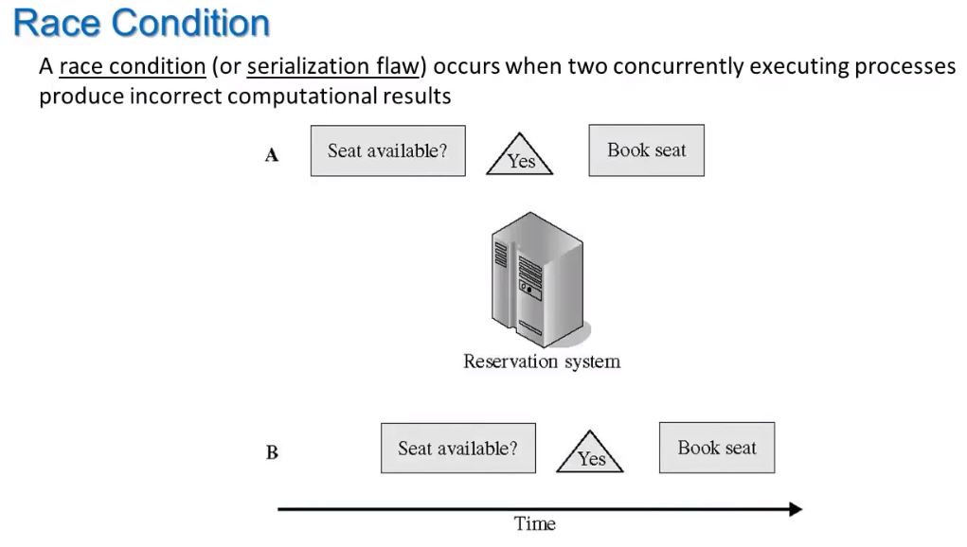
Race condition

Slide 19
Time-of-check to Time-of-use Errors(TOCTTOU)
Time-of-check to time-of-use flaw — often inadvertent (=> nonmalicious) but with serious security consequences
synchronization flaw / serialization flaw
TOCTTOU — mediation with “bait and switch” in the middle
Non-computing example:
Swindler shows buyer real Rolex watch (bait)
After buyer pays, switches real Rolex to a forged one
In computing:
Change of a resource (e.g., data) between time access checked and time access used

Slide 20
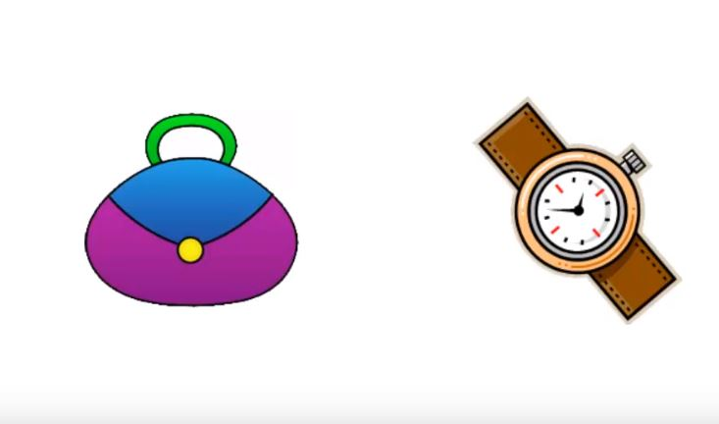

Slide 21
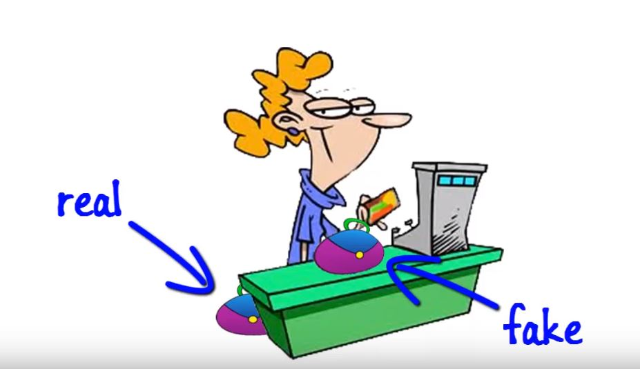

Slide 22
Q: Any examples of TOCTTOU problems from
computing?
A: E.g., DBMS/OS: serialization problem:
pgm1 reads value of X = 10
pgm1 adds X = X+ 5
→ pgm2 reads X = 10, adds 3 to X, writes X = 13
pgm1 writes X = 15
X ends up with value 15 – should be X = 18

Slide 23
Prevention of TOCTTOU errors
Be aware of time lags
Use digital signatures and certificates to “lock” data values after checking them
So nobody can modify them after check & before use
Q: Any examples of preventing TOCTTOU from
DBMS/OS areas
A1: E.g., DBMS: locking to enforce proper serialization
(locks need not use signatures—fully controlled by DBMS)
In the previous example:
will force writing X = 15 by pgm 1, before pgm2
reads X (so pgm 2 adds 3 to 15)
OR:
will force writing X = 13 by pgm 2, before pgm1
reads X (so pgm 1 adds 5 to 13)
An intelligent attacker uses each of the previously mentioned three flaws(buffer overflow, incomplete mediation, TOCTTOU) as one step in a multistep attack.

Slide 24
Penetrate and Patch
A method of judging software security in which a Red Team/Tiger Team intentionally tries to crack or break a software program.
Theory –if the program withstands the attack, then security is adequate.
Is this true?Rarely
Developers often try to quicky fix problems discovered by the Tiger Team
Quick Patches often introduce new faults due to
1.The pressure to repair a specific problem encouraged a narrow focus on the fault itself and not on its context. In particular, the analysts paid attention to the immediate cause of the failure and not to the underlying design or requirements faults.
2.The fault often had nonobvious side effects in places other than the immediate area of the fault. Fixing one problem often caused a failure somewhere else, or the patch addressed the problem in only one place, not in other related places.
3.The fault could not be fixed properly because system functionality or performance would suffer as a consequence

Slide 25
Viruses and other Malicious code
Work done by a program is invisible to users and they will not be aware of any malicious activity.
Example:
1. When is the last time you saw a bit?
2.Do you know in what format a document file is stored?
3.If a document is stored on a disk, can you tell the exact location where is it residing?
4.Which programs execute when we start our computer and how they are executed?
5. Can you tell if a game program does anything in addition to its expected interaction with you?
6. Which files are modified by a word processor when you create a document?
We cannot answer these question properly, since we don’t see computer data directly. Malicious people can make programs serve as vehicles to access and change data and other programs.

Slide 26
Malicious code
Malicious code executes just like any other program on the system. But, it is written to exploit the vulnerabilities of a system/software.
Malicious code can change: data and other programs.
Malicious can do anything like writing a message to the screen, stopping a running program, erasing a stored record etc. or sometimes malicious code will not do anything at all and stay dormant in the system.
Dormant malicious code just needs a trigger to become active.
Malicious codes are not new to computers, they have been in existence for the past few decades.

Slide 27
Trapdoors
Trojan Horses
X
Files
Bacteria
Worms
Logic Bombs
Viruses

Slide 28
Kinds of malicious code
Malicious code or a rogue program is the general name for unanticipated or undesired effects in programs or program parts, caused by an agent intent on damage.
Agent is the writer of the program or the person who causes its distribution.
Virus is a program that can replicate itself and pass onto other non malicious programs. A hidden, self-replicating section of computer software, usually malicious logic, that propagates by infecting (i.e., inserting a copy of itself into and becoming part of) another program. A virus cannot run by itself; it requires that its host program be run to make the virus active.
Virus can be: transient or resident
Transient virus has a life that depends on the life of its host.
Resident virus located itself in the memory and will be active in the system even after the attached program ends.

Slide 29
Trojan Horse
A computer program that appears to have a useful function, but also has a hidden and potentially malicious function that evades security mechanisms, sometimes by exploiting legitimate authorizations of a system entity that invokes the program
Trojan horse gets installed along with an infected legitimate program.
Effects of a Trojan horse:
Deleting, editing files.
Transmitting files to intruders.
Installing malicious code that can gain network access.
Privilege elevation attacks etc.
Worm is a program that replicates itself and spreads across a network of systems. Primary difference between a worm and a virus is that, a worm operates through networks whereas a virus spread through any medium.

Slide 30
Logic bomb is a special class of malicious code that “detonates” or goes off when a certain condition is met. Time bomb is a logic bomb whose trigger is time or date.
Trapdoor or backdoor is a feature in program, which provides an alternate entry or access to the program avoiding the direct calls and perhaps with special privileges.
Rabbit is a virus or a worm that replicates itself without any bound to exhaust the computing resources of a system.
Often the term “Virus” is used to refer to any malicious code.

Slide 31
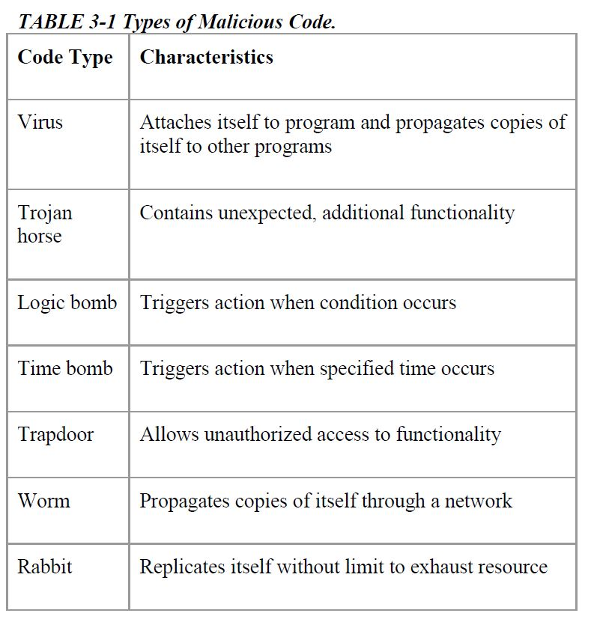

Slide 32
How viruses work?
Program containing virus must be executed to spread virus or infect other programs
Even one program execution suffices to spread virus widely
Virus actions: spread / infect
Spreading–Example 1: Virus in a program on installation CD
User activates program containing virus when she runs INSTALL or SETUP
Virus installs itself in any/all executing programs present in memory
Virus installs itself in programs on hard disk
From now on virus spreads whenever any of the infected programs (from memory or hard disk) executes

Slide 33
Spreading –Example 2:Virus in attachment to e-mail message
User activates program containing virus (e.g. macro in MS Word)by just opening the attachment
=> Disable automatic opening of attachments!!!
Virus installs itself and spreads
Spreading –Example 3: Virus in downloaded file
File with program or document(.doc, .xls, .ppt, etc.)

Slide 34
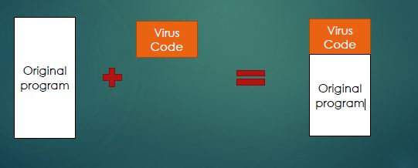
Kinds of viruses-based on their way of attaching
1.Appended Viruses
Appends to program. Often virus code precedes the program code execution by running its code before the 1st program instruction in executable file.
Executes whenever program gets executed.

Slide 35
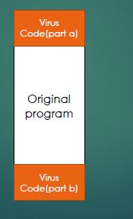
2. Surrounding viruses
Surrounds program
Executes before and after infected program
Intercepts its input/output
Erases its tracks
The “after” part might be used to mask virus
existence.
For example, a virus writer might want to prevent
the virus from being detected. If the virus is stored on disk, its presence will be given away by its file name, or its size will affect the amount of space used on the disk. The virus writer might arrange for the virus to attach itself to the program that constructs the listing of files on the disk. If the virus regains control after the listing program has generated the listing but before the listing is displayed or printed, the virus could eliminate its entry from the listing and falsify space counts so that it appears not to exist.

Slide 36
3. Integrating and replacing viruses
Integrates into program code
Spread within infected programs
(Replacing) virus V gains control over target program T by:
Overwriting T on hard disk
OR
Changing pointer to T with pointer to V
OS has File Directory
File Directory has an entry that points to file with code for T
Virus replaces pointer to T’s file with pointer to V’s file
In both cases actions of V replace actions of T when user executes what she thinks is “T”

Slide 37
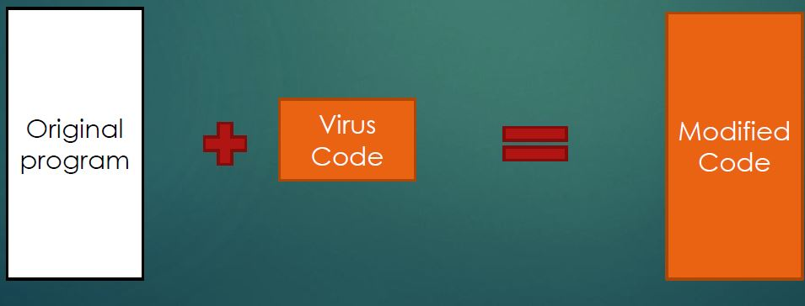
Integrating and replacing viruses

Slide 38
Document virus-one form of integrated virus
Spreads via picture, document, spreadsheet, slide presentation, database.
E.g., via .jpg, via MS Office documents .doc, .xls, .pptetc.
It is implemented within a formatted document, such as a written document, a database, a slide presentation, or a spreadsheet.
These documents are highly structured files that contain both data (words or numbers) and commands (such as formulas, formatting controls, links).
Commands are part of rich programming language.
Attacker uses these command portions to integrate his virus code with the document.
Ordinary user just sees the plain document but not the virus code embedded in commands portion.

Slide 39
Characteristics of a “Virus”
Hard to detect
Not easily destroyed or deactivated
Spreads infection widely
Can re-infect programs
Easy to create
Machine and OS independent

Slide 40
Homes for viruses
Most viruses are passed through e-mails or drive-by-downloads.
Attackers lure the victims to open the emails / click the malicious links that enable drive-by-download.
Ways for virus to take control over program:
Overwriting the complete program
Changing the pointer to point to a virus code instead of program on the disk.
One-time execution: majority of the viruses today execute only once, spreading their effect in that once execution.

Slide 41
Boot sector viruses
When OS is started, firmware detects the hardware components present, tests them and then transfers the control to the OS.
OS is invoked dynamically and not coded in the firmware.
OS resides on the disk. It is fetched into memory by a program called Bootstrap.
Firmware reads fixed number of bytes from a fixed location (boot sector) on the disk to a fixed location in the memory and jumps to that address for execution.
Often the boot sector size will be less than 512 bytes whereas the bootstrap loader will be of larger size.
To support this situation most of the hardware designers support “chaining”.

Slide 42
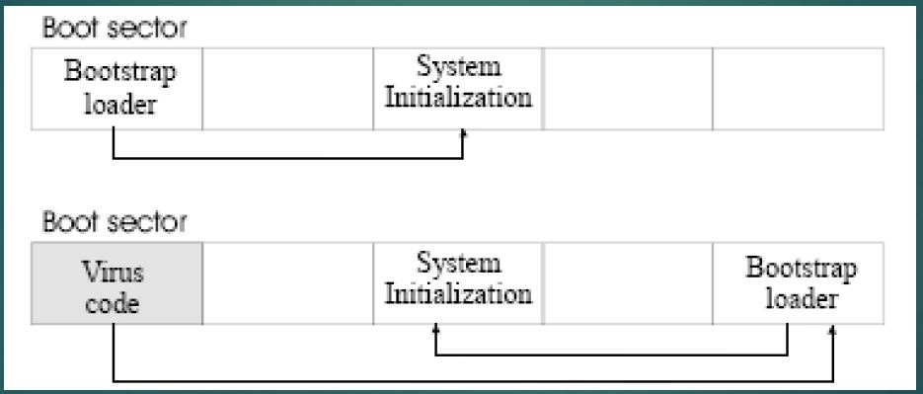
This chaining has both pros and cons.
Virus writer will simply break the chain at any point, inserts a pointer to the virus code, and reconnects the chain later .

Slide 43
Memory resident viruses
Most of the user programs will execute, terminate and disappear making space for other programs.
Few specialized programs are called very often and loading them each time takes a long time. So, OS keeps such programs and resident programs in the memory.
Ex: resident code that interprets the keys pressed on keyboard.
Resident routines are also called as “terminate and stay resident” TSR.
Viruses attach with this programs in memory so that virus gets control whenever this program is invoked.
This viruses are also capable of modifying Windows tables (registries).

Slide 44
Other homes for viruses
Other home is application programs, like spreadsheets, word processors having “macro” feature, by which user can record series of commands and can repeat same by single invocation.
Libraries are also excellent places for virus to reside. Often libraries are called from legitimate code and also libraries are shared between users.
Compilers, loaders, linkers, runtime debuggers and even virus control programs are good candidates for hosting viruses as they are mostly shared.

Slide 45
Virus signatures
Viruses executes in a particular way, using certain methods leaving some patterns.
These patterns of virus can be used to design programs like “virus scanners”.
Patterns can be:
1.Storage patterns
2.Execution patterns
3.Transmission patterns
Symantec reports on viruses gives statistical information on viruses.

Slide 46
Storage pattern
Often attached virus piece is invariant, so the start of the virus codes becomes detectable.
Virus attaches itself to a file, increasing the size of the file.
Else, virus can obliterate the actual code, which will not increase the size of the code but impacts the program functioning.
Virus scanner can use a code or checksum to detect changes to a file. It can also look for suspicious statements like JUMP at the starting instruction of the code.

Slide 47
Execution pattern
Most of the operations that a virus does are the common operations like removing directory, modifying files etc. which are common in OS.
Damage is bounded only by the creativity of the virus’s writer.

Slide 48
Transmission pattern
Virus travel is not confined to any single medium or execution pattern.
A virus may come through a network, reside in disk, may get attached to a program in execution, while executing may transfer a copy of itself to memory staying there as a resident and etc.
These transmissions have to be observed in order to detect virus patterns in the system.

Slide 49
Polymorphic viruses
Virus signatures or patterns are useful for a virus scanner to detect their existence in the systems.
Virus scanners look for such pre-defined patterns in the application code.
Intelligent virus writers can change these patterns just by sprinkling some no-ops(jumps, adding 0 to a num, comparing with itself) to distort the pattern.
A virus that can change its pattern/appearance is called as a polymorphic virus.
Ex: if a virus writer has 100 bytes of code and 50 bytes of data; there can be ‘n’ arrangements of this code using several jump statements.

Slide 50
Prevention of virus infection
Do not receive executable code from an unknown source.
But today, non executable file can have executable code, like macro’s in docs.
Hidden extension types are another problem, which deceives the user with a fake format.
Hiding and making the files as read-only will not prevent the attacks of virus.
Some prevention steps possible are:

Slide 51
Prevention of virus infection
Use only commercial software acquired from reliable, well-established vendors. There is always a chance that you might receive a virus from a large manufacturer with a name everyone would recognize. However, such enterprises have significant reputations that could be seriously damaged by even one bad incident, so they go to some degree of trouble to keep their products virus-free and to patch any problem-causing code right away. Similarly, software distribution companies will be careful about products they handle.
Test all new software on an isolated computer. If you must use software from a questionable source, test the software first on a computer with no hard disk, not connected to a network, and with the boot disk removed. Run the software and look for unexpected behavior, even simple behavior such as unexplained figures on the screen. Test the computer with a copy of an up-to-date virus scanner, created before running the suspect program. Only if the program passes these tests should it be installed on a less isolated machine.

Slide 52
Open attachments only when you know them to be safe. What constitutes "safe" is up to you, as you have probably already learned in this chapter. Certainly, an attachment from an unknown source is of questionable safety. You might also distrust an attachment from a known source but with a peculiar message.
Make a recoverable system image and store it safely. If your system does become infected, this clean version will let you reboot securely because it overwrites the corrupted system files with clean copies. For this reason, you must keep the image write-protected during reboot. Prepare this image now, before infection; after infection it is too late. For safety, prepare an extra copy of the safe boot image.

Slide 53
Make and retain backup copies of executable system files. This way, in the event of a virus infection, you can remove infected files and reinstall from the clean backup copies (stored in a secure, offline location, of course).
Use virus detectors (often called virus scanners) regularly and update them daily. Many of the virus detectors available can both detect and eliminate infection from viruses. Several scanners are better than one, because one may detect the viruses that others miss. Because scanners search for virus signatures, they are constantly being revised as new viruses are discovered. New virus signature files, or new versions of scanners, are distributed frequently; often, you can request automatic downloads from the vendor's web site. Keep your detector's signature file up-to-date.

Slide 54
Truths and misconceptions about viruses
1. Viruses can infect only Microsoft Windows systems. False
2. Viruses can modify "hidden" or "read only" files. True.
3. Viruses can appear only in data files, or only in Word documents, or only in programs. False.
4. Viruses spread only on disks or only in e-mail. False
5. Viruses cannot remain in memory after a complete power off/power on reboot. True.
6. Viruses cannot infect hardware. True.
7. Viruses can be malevolent, benign, or benevolent. True

Slide 55
Controls against program threats
Controlling against program threats is most effectively accomplished during the software development process
I.e. during the design, implementation, and testing of the software program.

Slide 56
Modularity
Modular software programs are composed of many subcomponents(modules), which are defined on a logical or functional basis.
Each module should meet four criteria:
It performs only one function
It is small
It is simple
It performs the task in isolation
By building software using a set of small, independent modules, the likelihood of security flaws is diminished.

Slide 57
Encapsulation
If a component is isolated from the effects of other components, then it is easier to trace a problem to the fault that caused it and to limit the damage the fault causes.
It is also easier to maintain the system, since changes to an isolated component do not affect other components.
And it is easier to see where vulnerabilities may lie if the component is isolated.
We call this isolation encapsulation.

Slide 58
Information hiding
Information hiding is another characteristic of modular software.
When information is hidden, each component hides its precise implementation or some other design decision from the others.
Thus, when a change is needed, the overall design can remain intact while only the necessary changes are made to particular components.

Slide 59
Mutual suspicion and Confinement
Mutual suspicion
When two programs must interact, each should be suspicious of the other
A program should never fully trust another program
A program should protect itself by:
Granting other programs only limited access
Checking/Validating input values supplied by other programs
Confinement
Programs that are suspected of being untrustworthy should be confined by the operating system in order to protect the system and other programs.
A confined program has very limited access to system resources and data.

Slide 60
Peer Reviews
In order to limit security flaws in software, the computer code written by one programmer may be reviewed by another
Non malicious security flaws
A peer review process can allow unintentional security flaws to be detected before they become a problem
Often when writing software, a programmer can become blind to his or her own mistakes- a peer review can catch these mistakes.
Malicious security flaws
A peer review process also greatly limits the possibility of intentional, malicious security flaws becoming part of a software program.
It is much more difficult for a programmer to embed a malicious security flaw in a program if his or her work is being reviewed by other programmers- unless there is collusion among all the programmers

Slide 61
Configuration Management
During the software development process, it is important to keep track of who is making which changes to the program-it is accomplished using configuration management.
Changes to one part of a program can have unintentional(or intentional) consequences for other parts of the program.
Configuration management allows undesirable changes to be rolled back as necessary.
Configuration management is particularly important for large software development projects and for the development of open-source software programs.

Slide 62
Other Software Development Security Controls
Hazard Analysis
A set of systematic techniques designed to reveal hazardous system states.
Prediction
Predicting which security problems are most dangerous or most likely to occur.
These predictions allow us to manage risk by targeting our limited resources to where they will be most useful.
Static Analysis
Examining a program’s code and design specifications for evidence of potential security threats.
Conducted before a system is developed-focuses on control flows, data flows, and data structure.
Analysis of mistakes
Learning from security breaches in order to avoid making the same mistakes in the future.
Requires that we document our design decisions so that we can review them when security breaches are identified.

Slide 63
Testing
Programs should extensively tested prior to development in order to ensure quality, stability and accuracy.
Unit testing
Testing(in isolation) the functionality and behavior of each component that comprises the program
Integration Testing
Testing the extent to which system components interact with one another as intended.
Function Testing
Evaluating the ability of the system to perform the functions for which it was designed
Performance Testing
Evaluating the ability of the system to achieve the performance standards for which it was designed.
Acceptance Testing
Evaluating the system capabilities against the requirements provided by the customer

Slide 64
Testing(continued)
Installation Testing
Evaluating whether the system functions correctly in its final production environement
Black box testing
Ensuring that a system generates correct output value in light of known input values
Does not consider the internal workings of the system.
White box testing
Testing a program by simulating an attack from external or internal threats
Regression testing
Testing whether all system functionalities are still working properly after change has been made.

Slide 65
Covert Channels: Programs That Leak Information
So far, we have looked at malicious code that performs unwelcome actions.
Next, we turn to programs that communicate information to people who should not receive it.
The communication travels unnoticed, accompanying other, perfectly proper, communications.
The general name for these extraordinary paths of communication is covert channels.

Slide 66
Covert Channels
In computer security, a covert channel is a type of attack that creates a capability to transfer information objects between processes that are not supposed to be allowed to communicate by the computer security policy.
A covert channel is so called because it is hidden from the access control mechanisms of secure operating systems since it does not use the legitimate data transfer mechanisms of the computer system (typically, read and write), and therefore cannot be detected or controlled by the security mechanisms that underlie secure operating systems.

Slide 67
Human example of covert channel
Suppose a group of students is preparing for an exam for which each question has four choices (a, b, c, d); one student in the group, Sophie, understands the material perfectly and she agrees to help the others.
She says she will reveal the answers to the questions, in order, by coughing once for answer "a," sighing for answer "b," and so forth.
Sophie uses a communications channel that outsiders may not notice; her communications are hidden in an open channel. This communication is a human example of a covert channel.

Slide 68
Storage channels - Communicate by modifying a "storage location", such as a hard drive.
Timing channels - Perform operations that affect the "real response time observed" by the receiver.

Slide 69
Timing Channels
Other covert channels, called timing channels, pass information by using the speed at which things happen. Actually, timing channels are shared resource channels in which the shared resource is time.
A service program uses a timing channel to communicate by using or not using an assigned amount of computing time.
In the simple case, a multiprogrammed system with two user processes divides time into blocks and allocates blocks of processing alternately to one process and the other.
A process is offered processing time, but if the process is waiting for another event to occur and has no processing to do, it rejects the offer. The service process either uses its block (to signal a 1) or rejects its block (to signal a 0).

